Slide 1
M.KUMARASAMY COLLEGE OF ENGINEERING , KARUR.
Register Number : 927623BEE001,927623BEE055
Name : ABARNA S, MONIGASHREE S
Date : 05.06.2025

Slide 2
TITLE OF THE PROJECT
Inventory Management System

Slide 3
Literature Review
Year | Authors | Title of the Paper | Algorithm/ Methodologies/ Techniques | Findings
2020 | Smith et al. | “Efficient Inventory Tracking using Relational Databases" | SQL, Normalization, Entity-Relationship (ER) Modeling | Improved efficiency in inventory tracking and reduced redundancy
2021 | Kumar et al. | “Predictive Analytics in Inventory Control" | Machine Learning, Data Mining, SQL Queries | Improved demand forecasting and stock optimization

Slide 4
Problem(s) Identified
1. Data Management Issues
Inconsistent Data Entry – Users might input incorrect or inconsistent product names, supplier details, or order records.
Data Duplication – Repeated entries of products, suppliers, or orders can cause confusion and errors.
Scalability – The system should efficiently handle increasing amounts of inventory and orders over time.
2. Stock Management Challenges
Real-Time Stock Updates – Ensuring that stock levels are updated immediately after sales, purchases, or returns.
Stock Discrepancies – Differences between recorded and actual stock due to human error, theft, or damages.
Low Stock Alerts – Implementing effective notification systems for when stock levels are low.
3. Report Generation Issues
Complex Data Analysis – Generating meaningful sales and inventory reports from raw data.
Report Customization – Allowing users to filter and customize reports based on different parameters.
Slow Report Processing – Ensuring that report generation does not slow down the system, especially with large datasets.

Slide 5
Objectives
To automate inventory tracking and reduce manual record-keeping errors.
To ensure real-time stock updates for accurate inventory monitoring.
To enhance data accuracy and consistency using database normalization and integrity constraints.
To enable fast and efficient item searching and retrieval through optimized SQL queries.
To reduce overstocking and stock shortages by implementing an optimized inventory control mechanism.
To improve decision-making by generating reports on stock levels, sales, and trends.
To ensure data security and backup by implementing user authentication and database recovery mechanisms.
To integrate inventory management with other business systems such as sales, purchasing, and accounting.

Slide 6
Proposed Solution
1. Product & Supplier Management
Store product details (SKU, name, category, price) and supplier information (contact, lead time).
Solution: Use a relational database (MySQL/PostgreSQL) with unique identifiers for products and suppliers.
2. Stock Management
Track stock levels in real time to prevent shortages or overstocking.
Solution: Implement database triggers for instant stock updates and barcode/QR code scanning to improve accuracy.
3. Order Management
Allow placing, tracking, and updating order statuses (Pending, Shipped, Delivered).
Solution: Use a REST API to manage order processing and integrate with supplier systems.
4. Automated Alerts & Notifications
Send alerts for low stock, expired items, or pending orders.
Solution: Use threshold-based alerts and push/email notifications.
5. Report Generation & Analytics
Generate inventory, sales, and supplier performance reports.
Solution: Optimize SQL queries, enable customizable reports, and support exports in multiple formats (CSV, PDF, Excel).

Slide 7
Architecture Diagram
USER INTERFACE
1. Add/Edit Products
2. Manage Stock
3. Place Orders
4. Generate Reports
Web or Desktop App
APPLICATION LAYER(PYTHON,PHP)
1. Processes Requests
2. Handles Business Logic
Business Logic
DATABASE(DBMS)
1. Stores Products
2. Tracks Suppliers
3. Manage Orders
4. Generate Reports
MySQL, PostgreSQL

Slide 8
Architecture Diagram Explanation
1. User Interface (Frontend)
Purpose: This is where users interact with the system. Features:
Add/Edit Products
Manage Stock Levels
Place Orders
Generate Reports
Example: A store manager can log in, check stock levels, and order new products.
2. Application Layer (Backend)
Purpose: Handles all business logic and database operations. Functions:
Processes user requests (e.g., updating stock levels after a sale).
Connects the user interface to the database.
Validates and secures data before storing it.
Example: When a user places an order, the backend updates the stock quantity in the database.
3. Database Management System (DBMS)
Purpose: Stores and manages inventory data.
Products Table: Stores product details like name, category, price, and stock quantity.
Suppliers Table: Stores supplier information for restocking inventory.
Orders Table: Keeps track of product purchases and sales.
Example: When a new product is added, it is stored in the database with all relevant details.

Slide 9
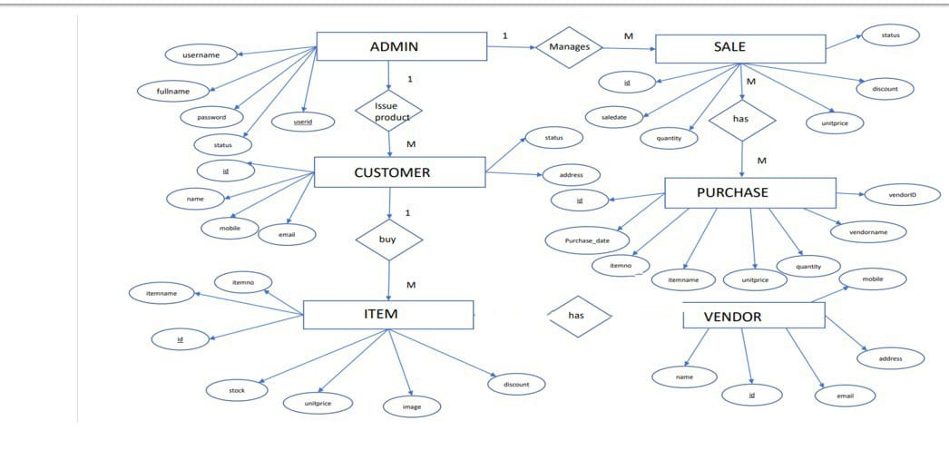
ER diagram
M
M

Slide 10
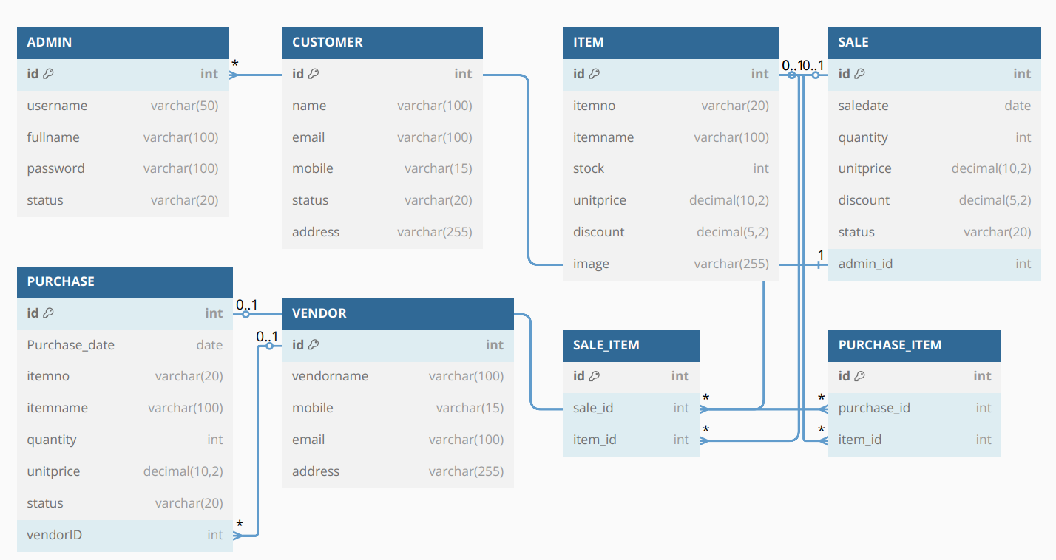
SCHEMA DIAGRAM

Slide 11
QUERIES
CREATE TABLE Users (
user_id INT AUTO_INCREMENT PRIMARY KEY,
username VARCHAR(50) NOT NULL UNIQUE,
email VARCHAR(100) NOT NULL UNIQUE,
password_hash VARCHAR(255) NOT NULL,
role VARCHAR(20) DEFAULT 'staff',
created_at DATETIME DEFAULT CURRENT_TIMESTAMP
);
CREATE TABLE Products (
product_id INT AUTO_INCREMENT PRIMARY KEY,
name VARCHAR(100) NOT NULL,
sku VARCHAR(50) NOT NULL UNIQUE,
category VARCHAR(50),
description TEXT,
price DECIMAL(10,2) NOT NULL,
created_at DATETIME DEFAULT CURRENT_TIMESTAMP,
created_by INT,
FOREIGN KEY (created_by) REFERENCES Users(user_id)
);

Slide 12
QUERIES
CREATE TABLE Inventory (
inventory_id INT AUTO_INCREMENT PRIMARY KEY,
product_id INT NOT NULL,
quantity INT NOT NULL DEFAULT 0,
location VARCHAR(100),
last_updated DATETIME DEFAULT CURRENT_TIMESTAMP ON UPDATE CURRENT_TIMESTAMP,
FOREIGN KEY (product_id) REFERENCES Products(product_id)
);
CREATE TABLE Inventory_Log (
log_id INT AUTO_INCREMENT PRIMARY KEY,
product_id INT NOT NULL,
user_id INT NOT NULL,
action VARCHAR(20) NOT NULL, -- 'add', 'update', 'delete'
quantity INT NOT NULL,
timestamp DATETIME DEFAULT CURRENT_TIMESTAMP,
notes TEXT,
FOREIGN KEY (product_id) REFERENCES Products(product_id),
FOREIGN KEY (user_id) REFERENCES Users(user_id)
);

Slide 13
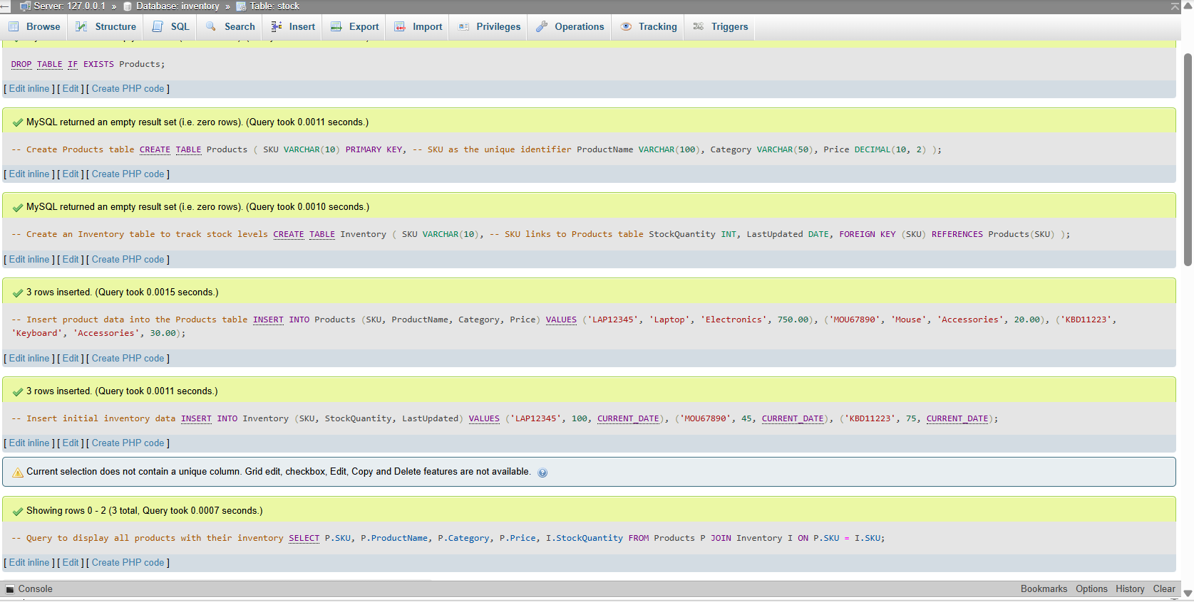
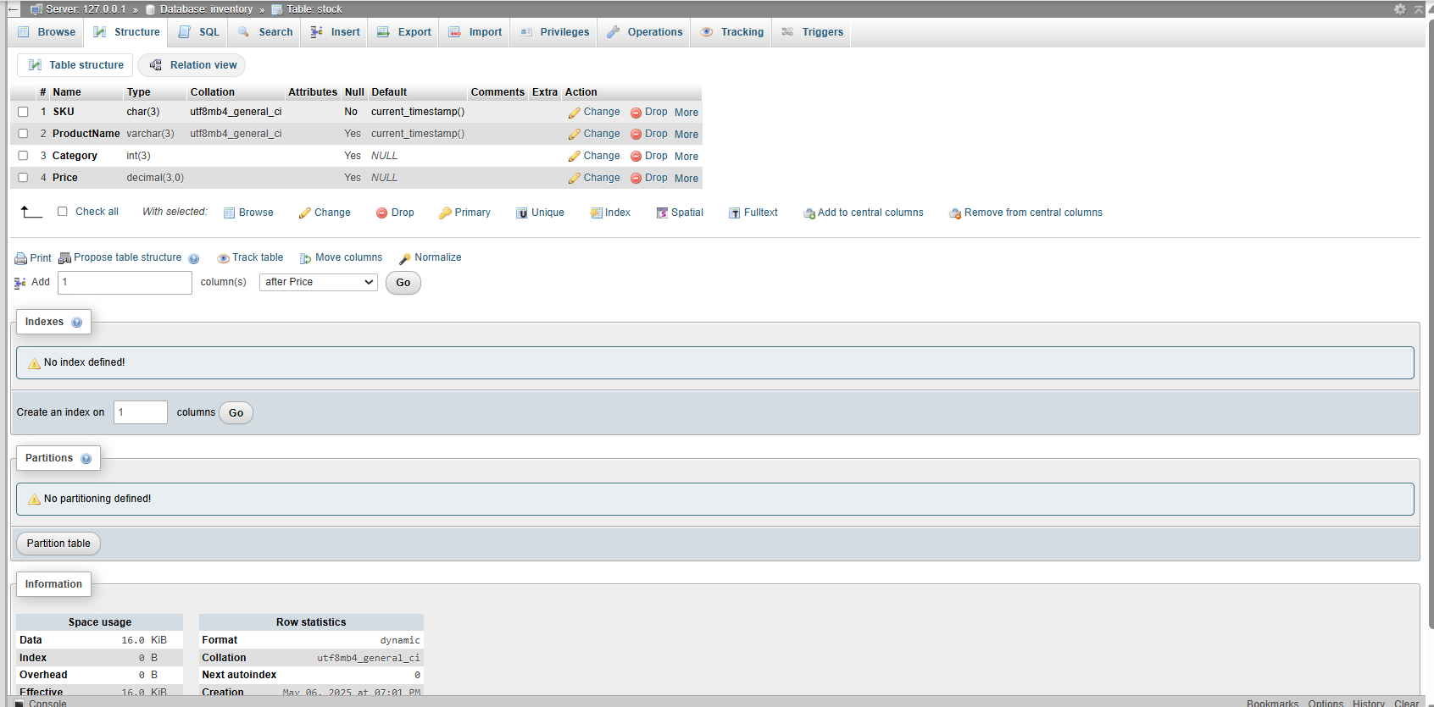
FINAL OUTPUT

Slide 14
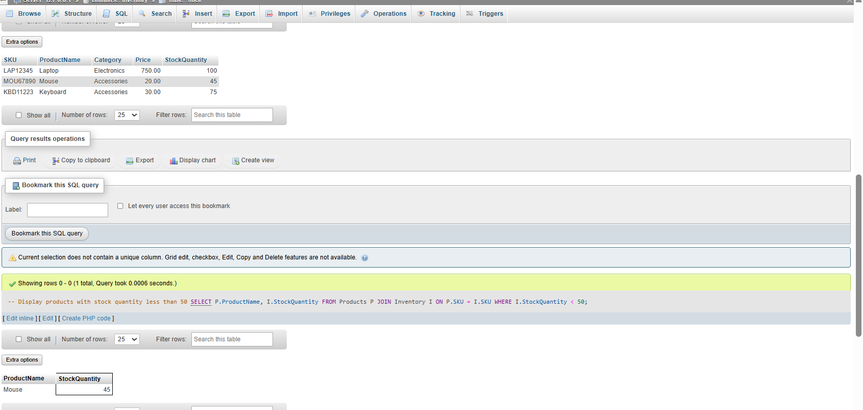
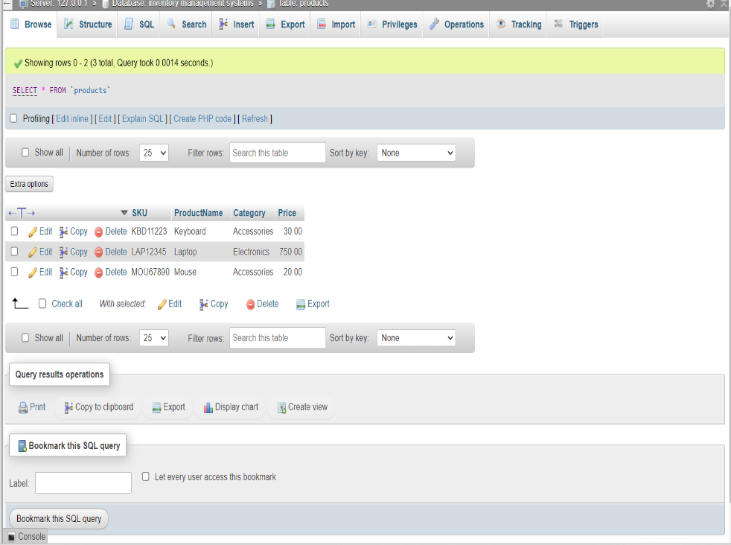
FINAL OUTPUT

Slide 15
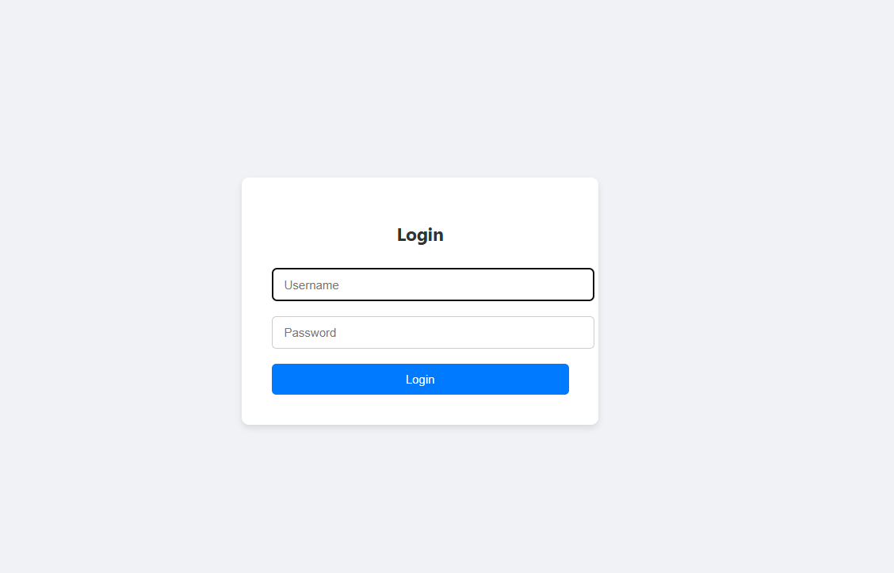
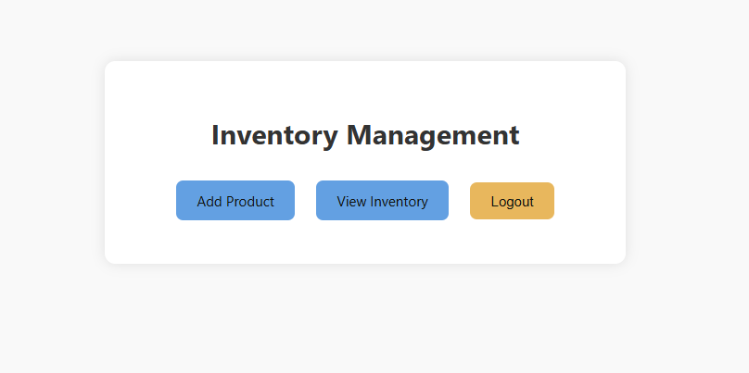
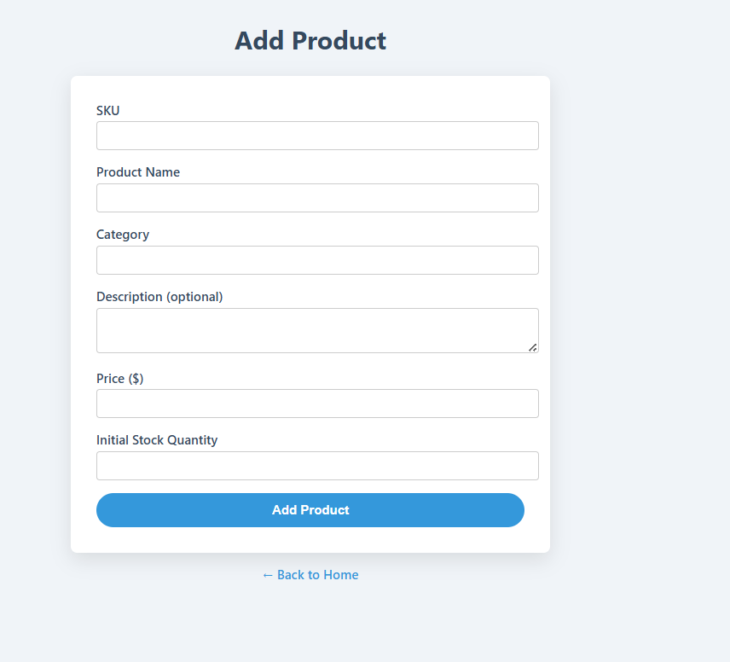
FRONTEND OUTPUT
M
M

Slide 16
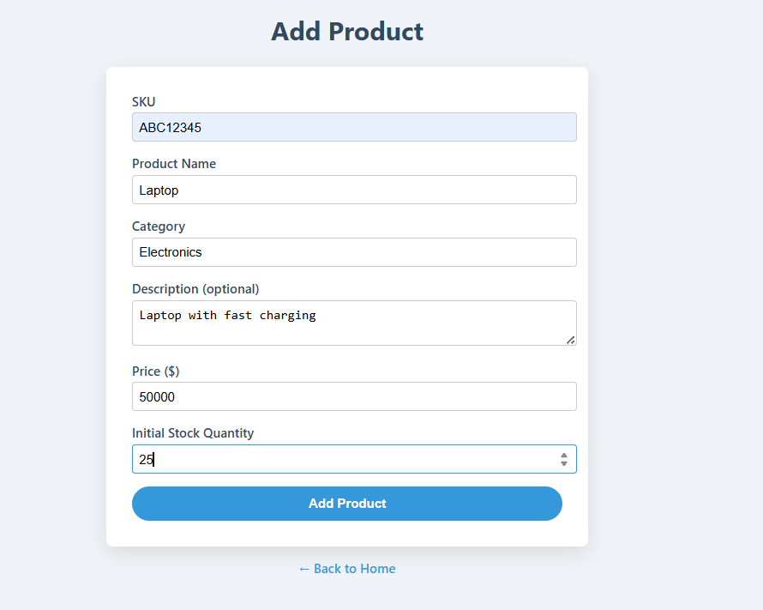
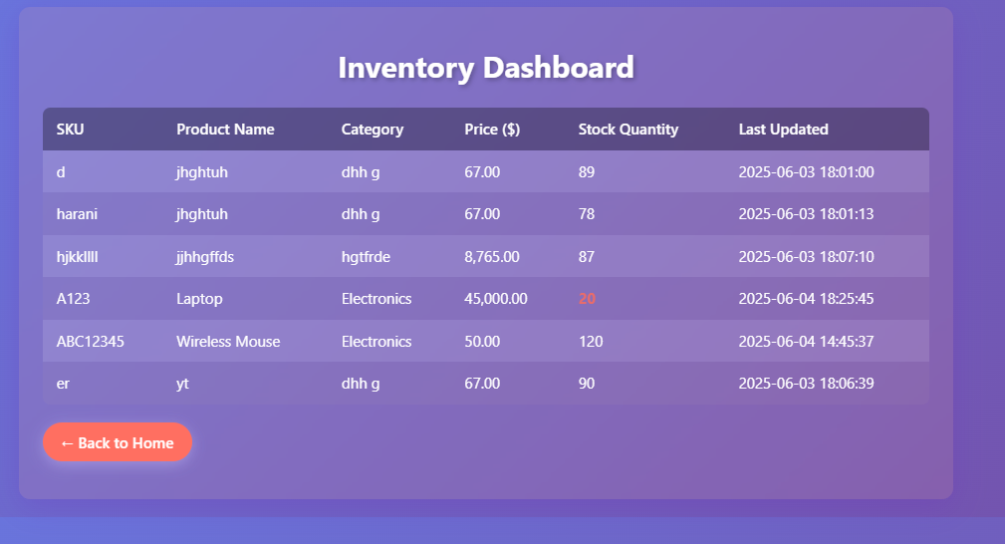
FRONTEND OUTPUT
M
M

